Slide 1

Recommending neighborhoods in Austin, Texas
Anastasia Efremova
efremova.nastya@gmail.com
https://github.com/nastikas/Austin-Analysis

Slide 2
Introduction
What:
In this project, my goal is to assist people in recommending neighborhoods in Austin that meet their personalized needs. The application can collect user preferences by answering simple questions and then a list of recommended neighbors will be returned.
Why:
As an immigrant and traveler, I know how hard it is to find a good neighborhood to live in, especially in an unfamiliar area or under a time restraint. Not many people love to do deep research. Also, one of the most popular questions online is: “which area should I live with my family”.
How:
I have 16 years of public crime reports from the Austin police department. This dataset contains a record of incidents that the Austin Police Department responded to and wrote a report.
Next is the real estate market. I am going to collect all addresses in Austin and surrounding areas from the County appraisal district and going to use them to collect information about houses from the Zillow library (PyZillow) with free open Zillow API.

Slide 3
The plan
Collecting Raw Will County
Collecting Raw Travis County
Austin Crime Data
Cleaned Will
Cleaned Trav
Ceaned
Austin Crime Data
Trav + Will = County_Data
Zillow API
House Data

Slide 4
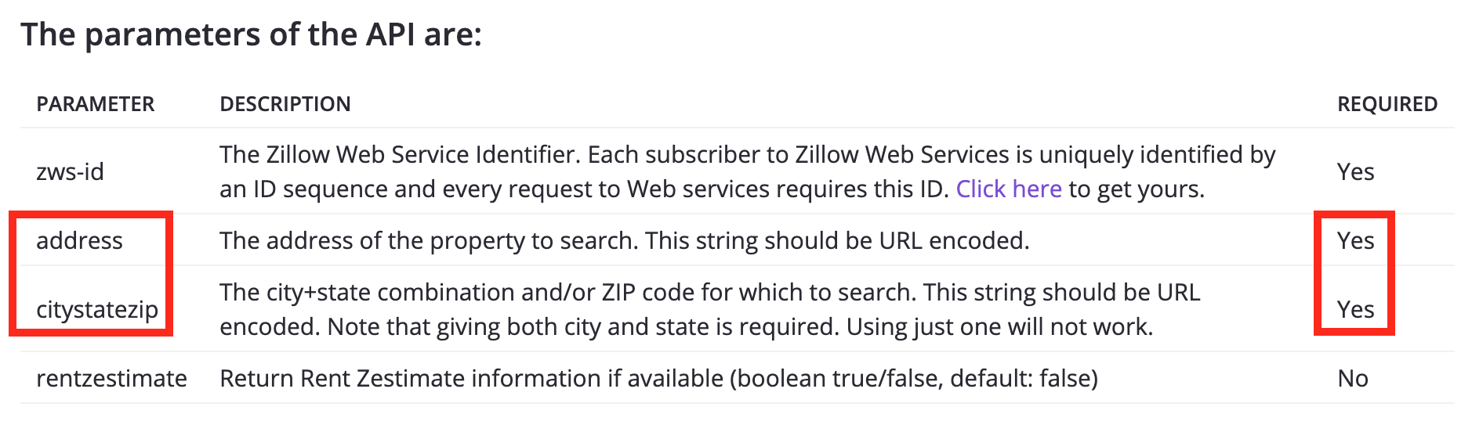
Getting Data - Zillow

Slide 5
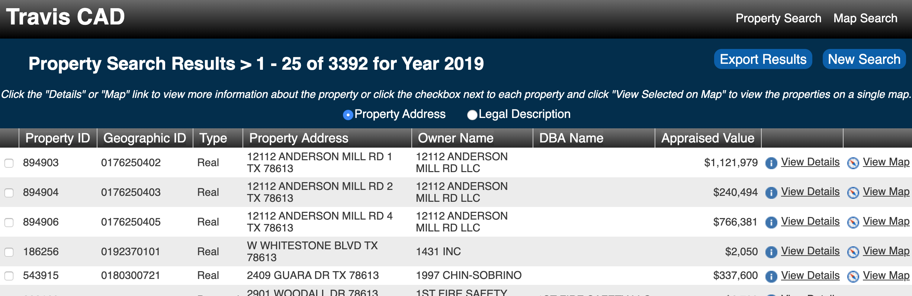
CAD
Williamson County + Travis County

Slide 6
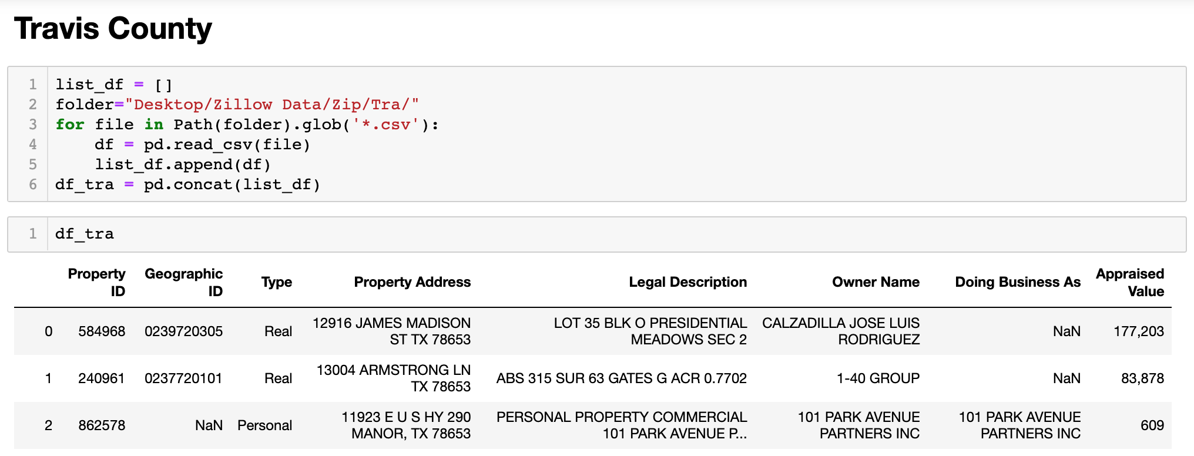

Slide 7



Cleaning County Data
Deleting personal info
Separating address and zipcode
Deleting businesses
Deleting duplicates
Deleting $ from Appraised Value

Slide 8
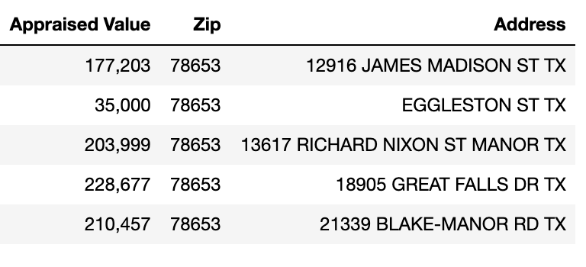
Cleaned Travis County

Slide 9
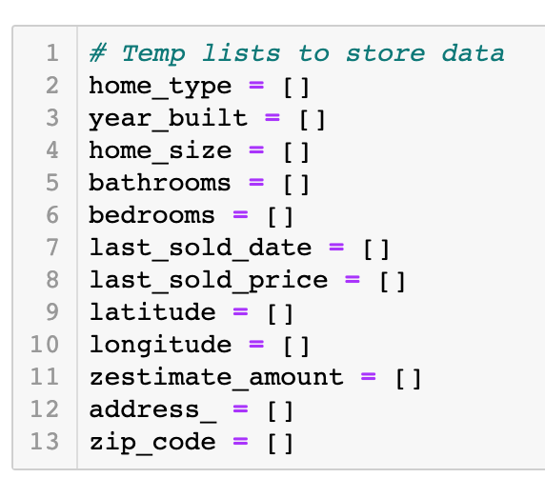
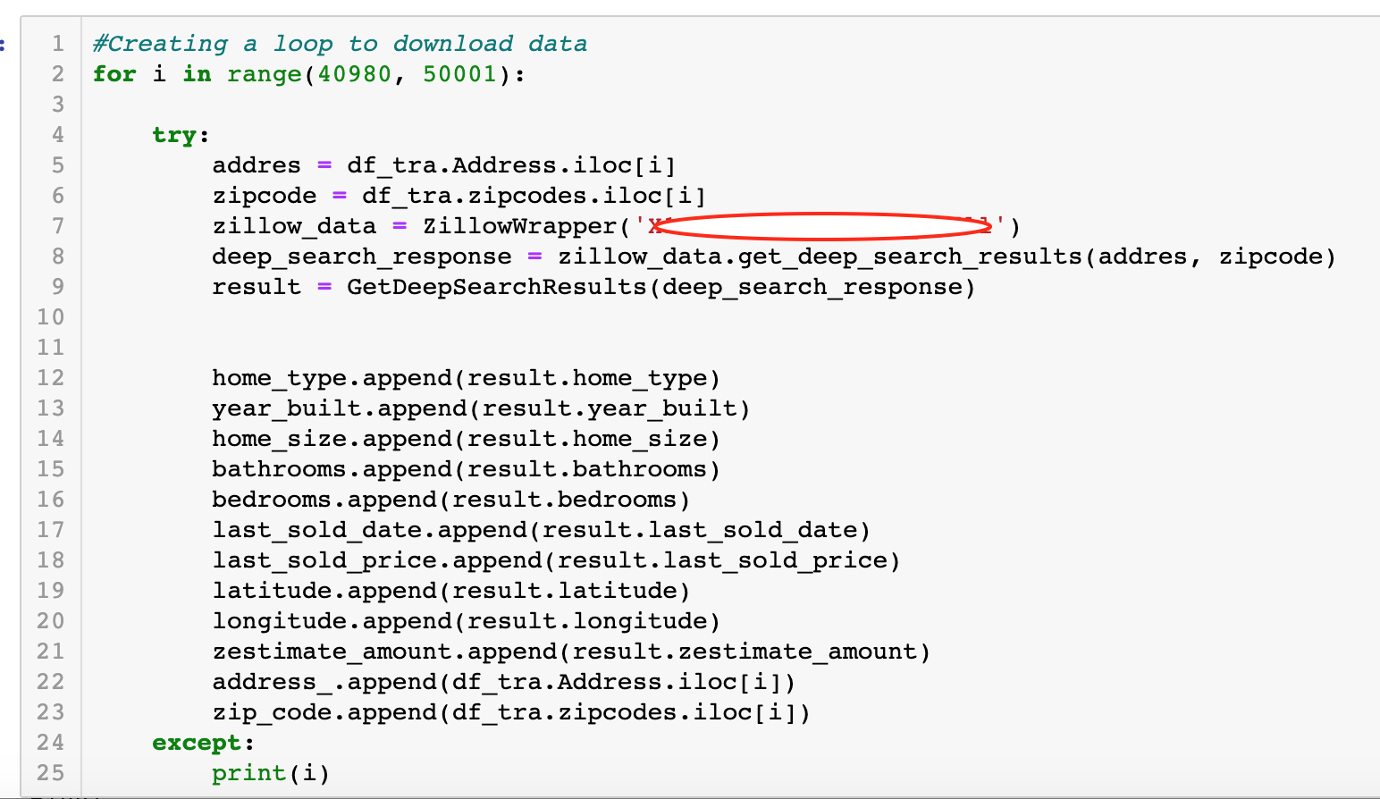
Zillow Data API Collector

Slide 10
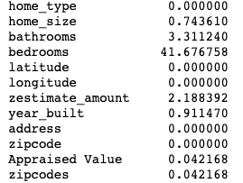
Cleaning Data from Zillow
Input bedrooms using simple "Br = Bth + 1" formula
Delete missing values
Removing VacantResidentialLand, Mobile, Unknown, Miscellaneous
Checking for outliers
changing data types, column names (for merging)

Slide 11
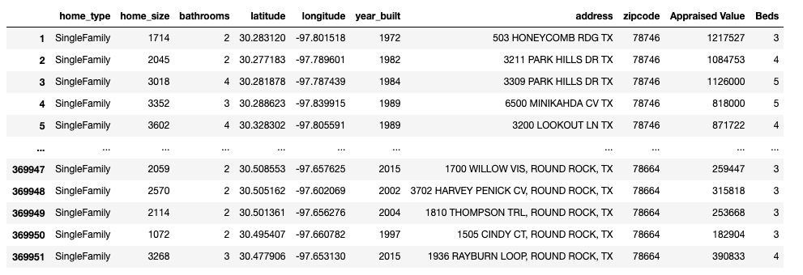
House Data

Slide 12
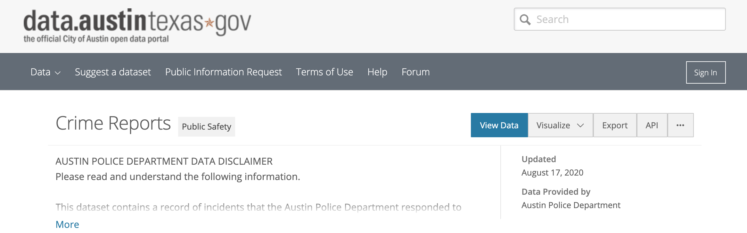
Getting Austin Crime Data

Slide 13
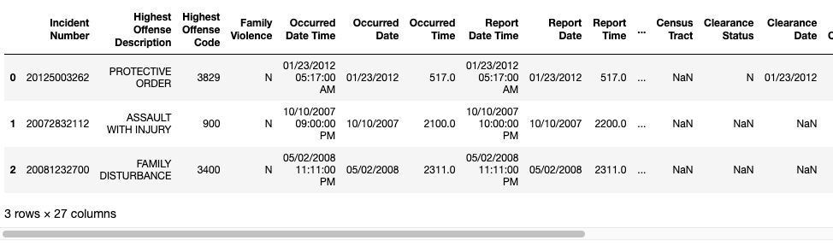
Cleaning Austin Crime Data
2259648 entries

Slide 14
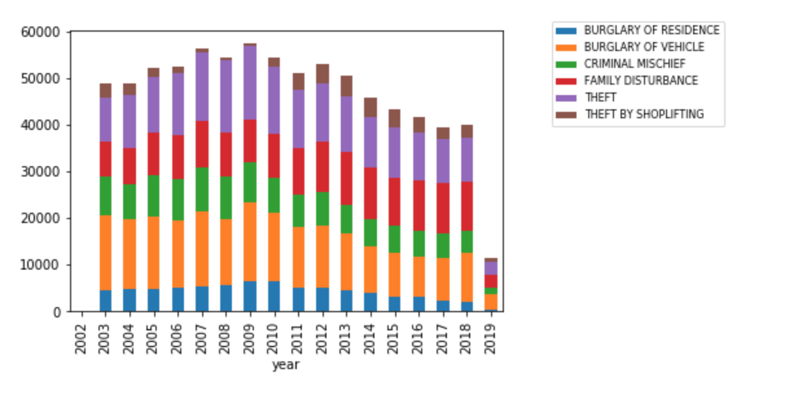
Data exploration

Slide 15
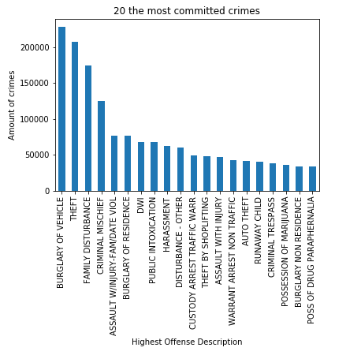
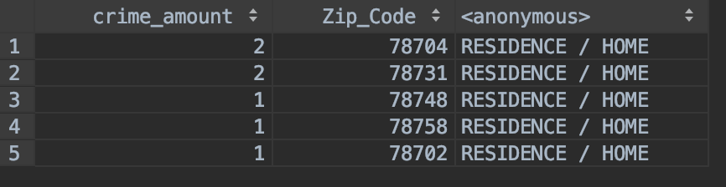
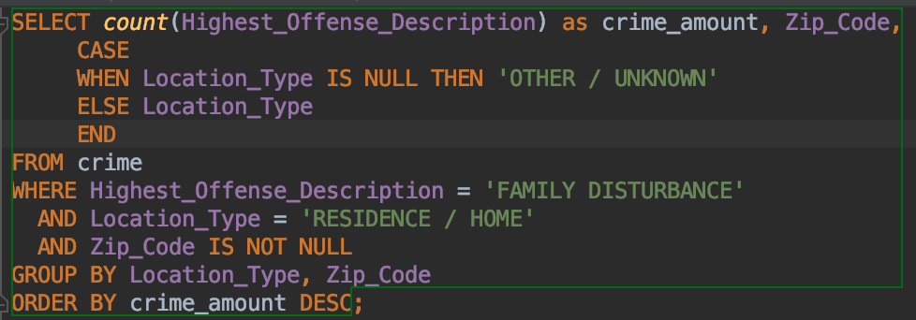
Going deeper with SQL Example

Slide 16
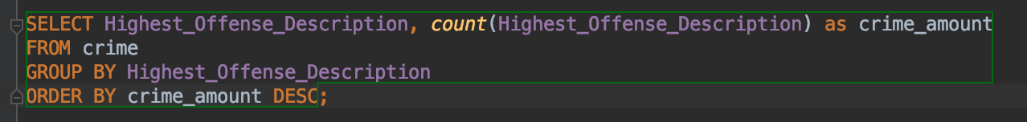
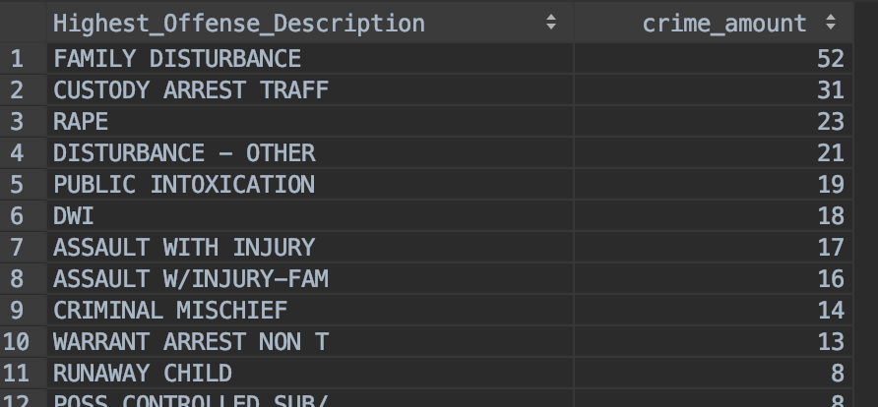
The Most Committed Crimes - SQL example on Sampled Data

Slide 17
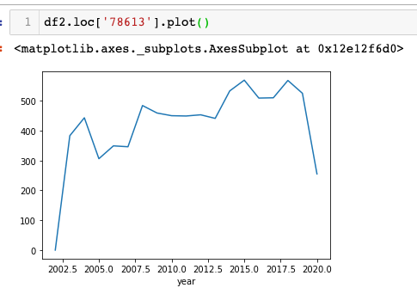
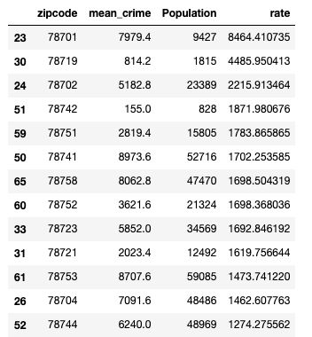
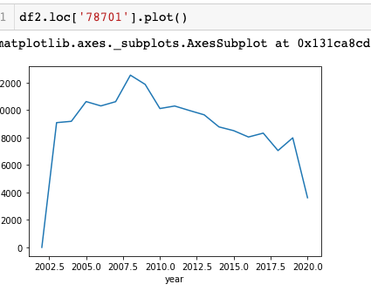
Calculating Rate

Slide 18
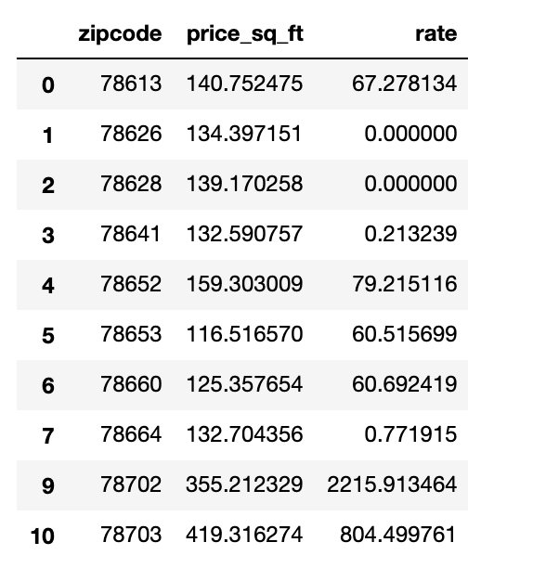
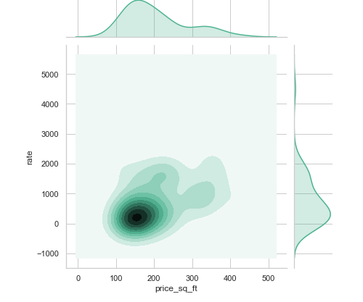
Combining all together

Slide 19
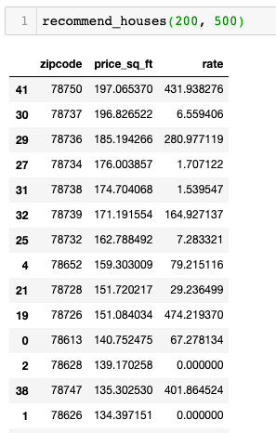

Slide 20
Thank you for your attention!
Anastasia Efremova
efremova.nastya@gmail.com
github.com/nastikas

